Slide 1
CSC101 – Introduction to ICT Lecture 08 Nested loops
Course Instructors
Dr. Majid Iqbal Khan Dr. Ashfaq Hussain Farooqi Mr. Rizwan Rashid Ms. Sajida Kalsoom

Slide 2
Nested Loops
A loop can be nested inside another loop.
Nested loops consist of an outer loop and one or more inner loops.
For each iteration of the outer loop, all the iterations of the inner loops are performed.
Nested for loops:
for i in sequence:
for j in sequence:
statements
statements
Nested while/for loops:
while expression:
for i in sequence:
statements
statements
Nested while loops:
while expression:
while expression:
statements
statements
Nested for/while loops:
for i in sequence:
while expression:
statements
statements

Slide 3
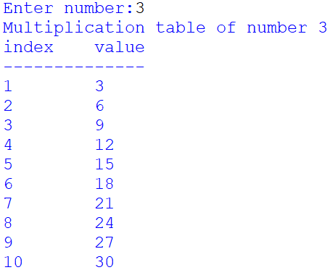
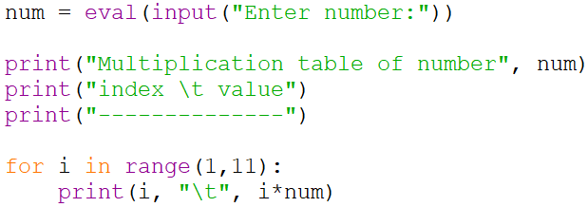
Loops - Print the table of the number x

Slide 4
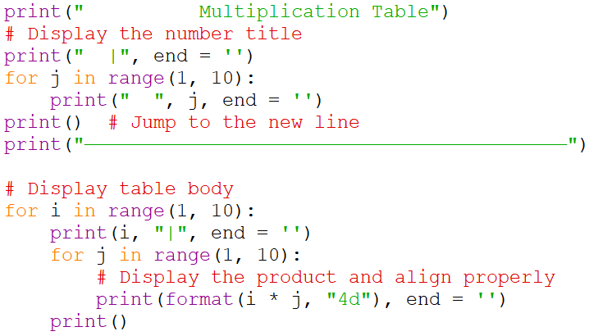
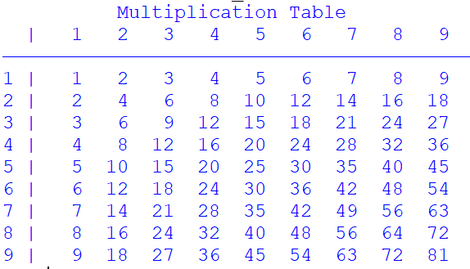
Nested for Loops example - multiplication table

Slide 5
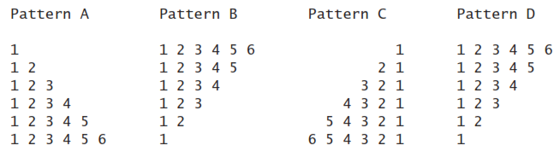
Nested for Loops exercise

Slide 6

Nested while Loops example
Check balance
Enter 4 digit pin
Deposit money
Return card

Slide 7
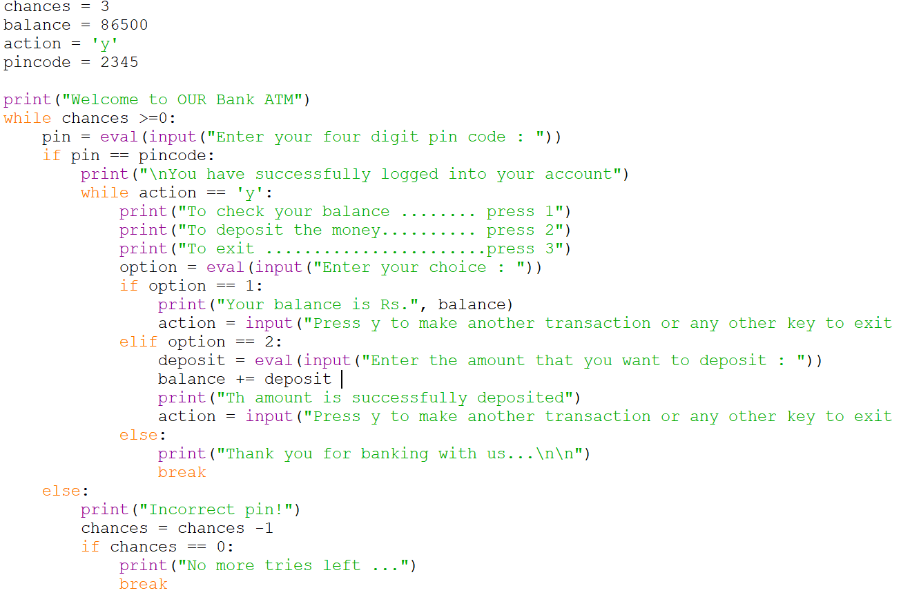
Nested while Loops example

Slide 8
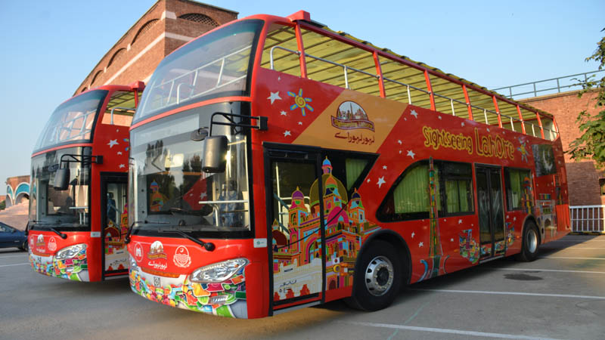
Nested while-for Loops example
Tourist bus reservation program that asks for the number of seats to reserve and then collects following details about the tourists
Name
Age
Nationality

Slide 9
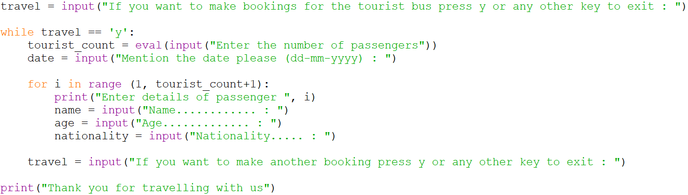
Nested while-for Loops example

Slide 10
Summary
Nested loops in different configurations
for – for
while – while
while – for
for – while
Next lecture will be on List

